Slide 1
Breast Cancer Data Meets Machine Learning
By: Samriddh Gupta
CSC:493 Computer Science Capstone Project
Prof. Owrang

Slide 2

Introduction
The main focus of this project was to see whether using machine leaning, Can we find some relations between the survival of patients to other attributes that was present in the data.
And finally using those relations, can we make some kind of model which can help us predict some results.

Slide 3
Different Analysis
There are multiple Machine learning algorithm that I used.
All of them showed me different results and I have summaries those results here in these slides.
I have multiple results here and some of them is great and some are not.

Slide 4
Neural Net For Survival Months
I used neural net to find whether survival in months have any relation with Age, Lymph Nodes, Tumor size and tumor extensions.
I used different hidden layers and to train the training dataset and test them on testing dataset. And I will be sawing my results and graphs here

Slide 5
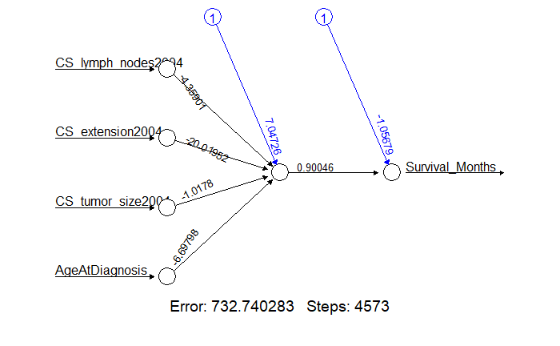
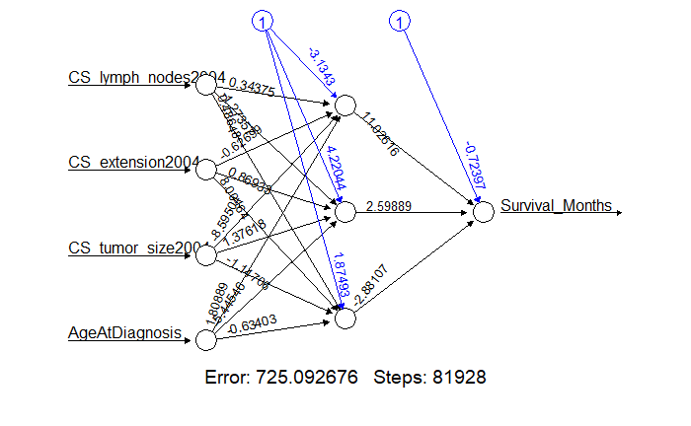
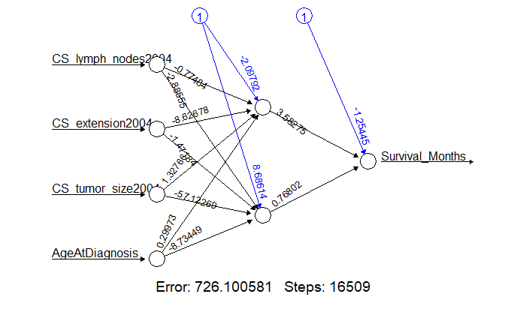
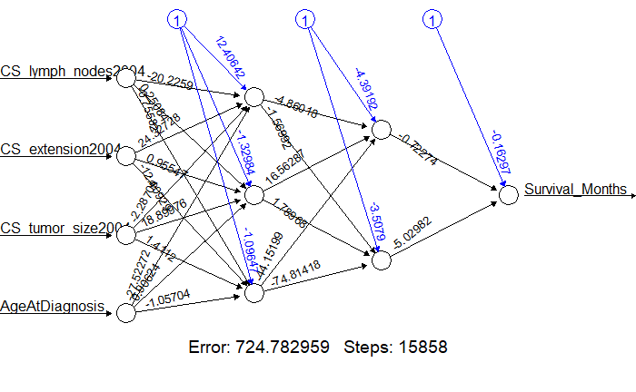
Error probability:
0.9873064
Error probability:
0.9909639
Error probability:
0.9898881
Error probability:
Gives an Error

Slide 6
Explanation of the Result
All those probabilism are really bad and have high Errors.
Since I was trying to make confusion Matrix, Their values have to be Identical.
I used normalization so that months are between 0 and 1 and while converting the values, There might be some errors which could cause this problem.
The Variable that I have selected might not have any relation or there are more variable which I did not include in data, which could have result in this high error.

Slide 7
Neural Net For Survival
In this neural net I conform the relation between Whether the patient is alive or dead with the age, Lymph Nodes, Tumor size and tumor extensions.
Like earlier I use different hidden layers here to get multiple models.

Slide 8
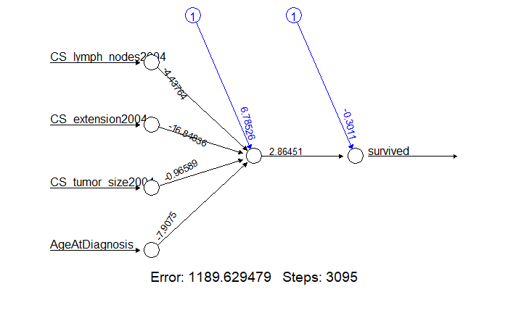
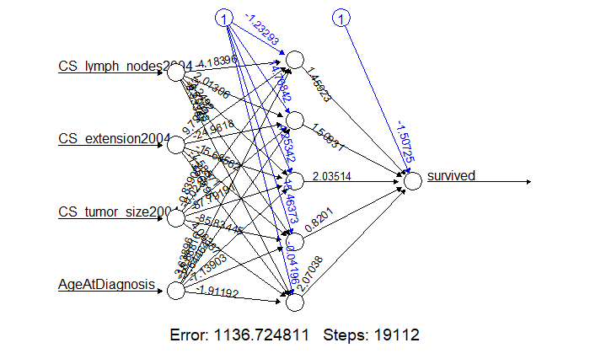
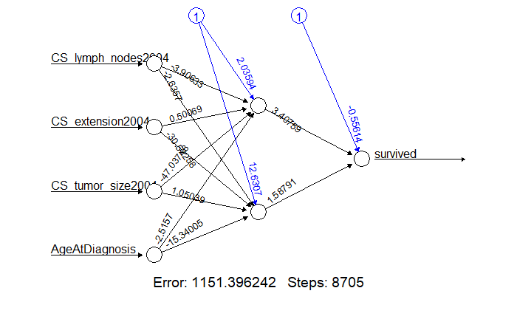
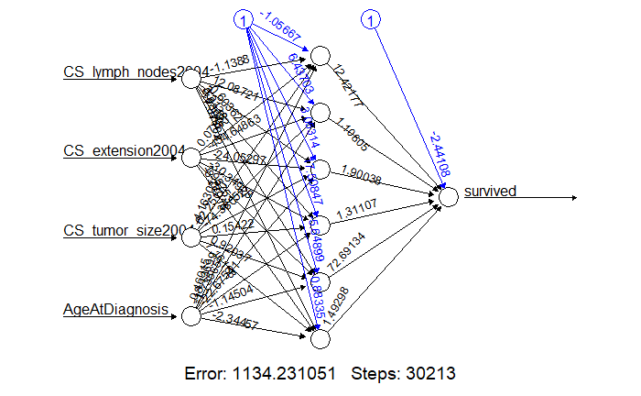
pred 0 1
0 292 147
1 847 3362
Error: 0.2138554
pred 0 1
0 268 131
1 871 3378
Error: 0.2155766
pred 0 1
0 292 147
1 847 3362
Error: 0.2138554
pred 0 1
0 252 124
1 887 3385
Error: 0.2175129

Slide 9
Explanation of the Result
The error is comparatively a lot less and gives more accurate predictions for the Alive or dead than survival in months.
I think most of the variables selected here are more correlated and by adding few more variables we could get even better results.
We sees that after 5 hidden layers the error term is not changing but the True positive and true negatives are changing respectively. I think that one model is better for dead and other is better of living.

Slide 10
Decision Tree
Decision tree is the most powerful and popular tool for classification and prediction. A Decision tree is a flowchart like tree structure, where each internal node denotes a test on an attribute, each branch represents an outcome of the test, and each leaf node (terminal node) holds a class label.
I made a number of decision trees in my project with multiple variable, but the one That I am going to explain is the one which uses all of the variables and predicts your chance of survival.

Slide 11
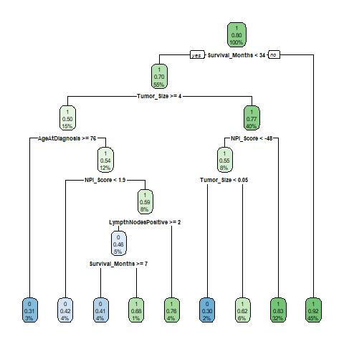

Slide 12
Linear Regression
Linear regression attempts to model the relationship between two variables by fitting a linear equation to observed data. One variable is considered to be an explanatory variable, and the other is considered to be a dependent variable.
In this case we use Survival months as our dependent variable and rest are my explanatory variable.
This is the model which I got:
Y= 28.54067 - 0.04512 * (X1) + 0.07564 * (X2) + 12.32351 * (X3) - 0.54310 * (X4) - 0.58474 * (X5) + 0.63392 * (X6) - 0.08749 * (X7)
Where Y= Survival Months, X1= Age at Diagnosis, X2= Tumor Size, X3= survived, X4= NPI Score, X5= Ethnicity Race Class, X6= Lymph Nodes Positive, X7= Marital Status

Slide 13
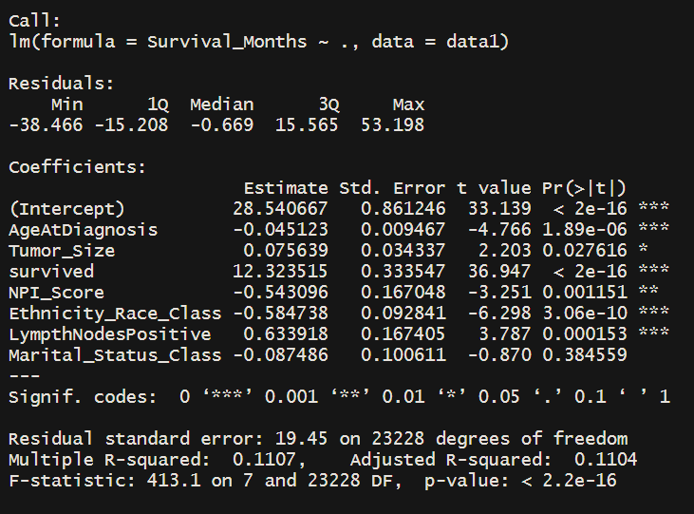
Why was it not sufficient?
Even if we got that model, the variables we not correlated, which mean that they do not have any relation which one another.
P-value of multiple variables are quite low and the ones that do have high p-value are not that significant as they are misleading.

Slide 14
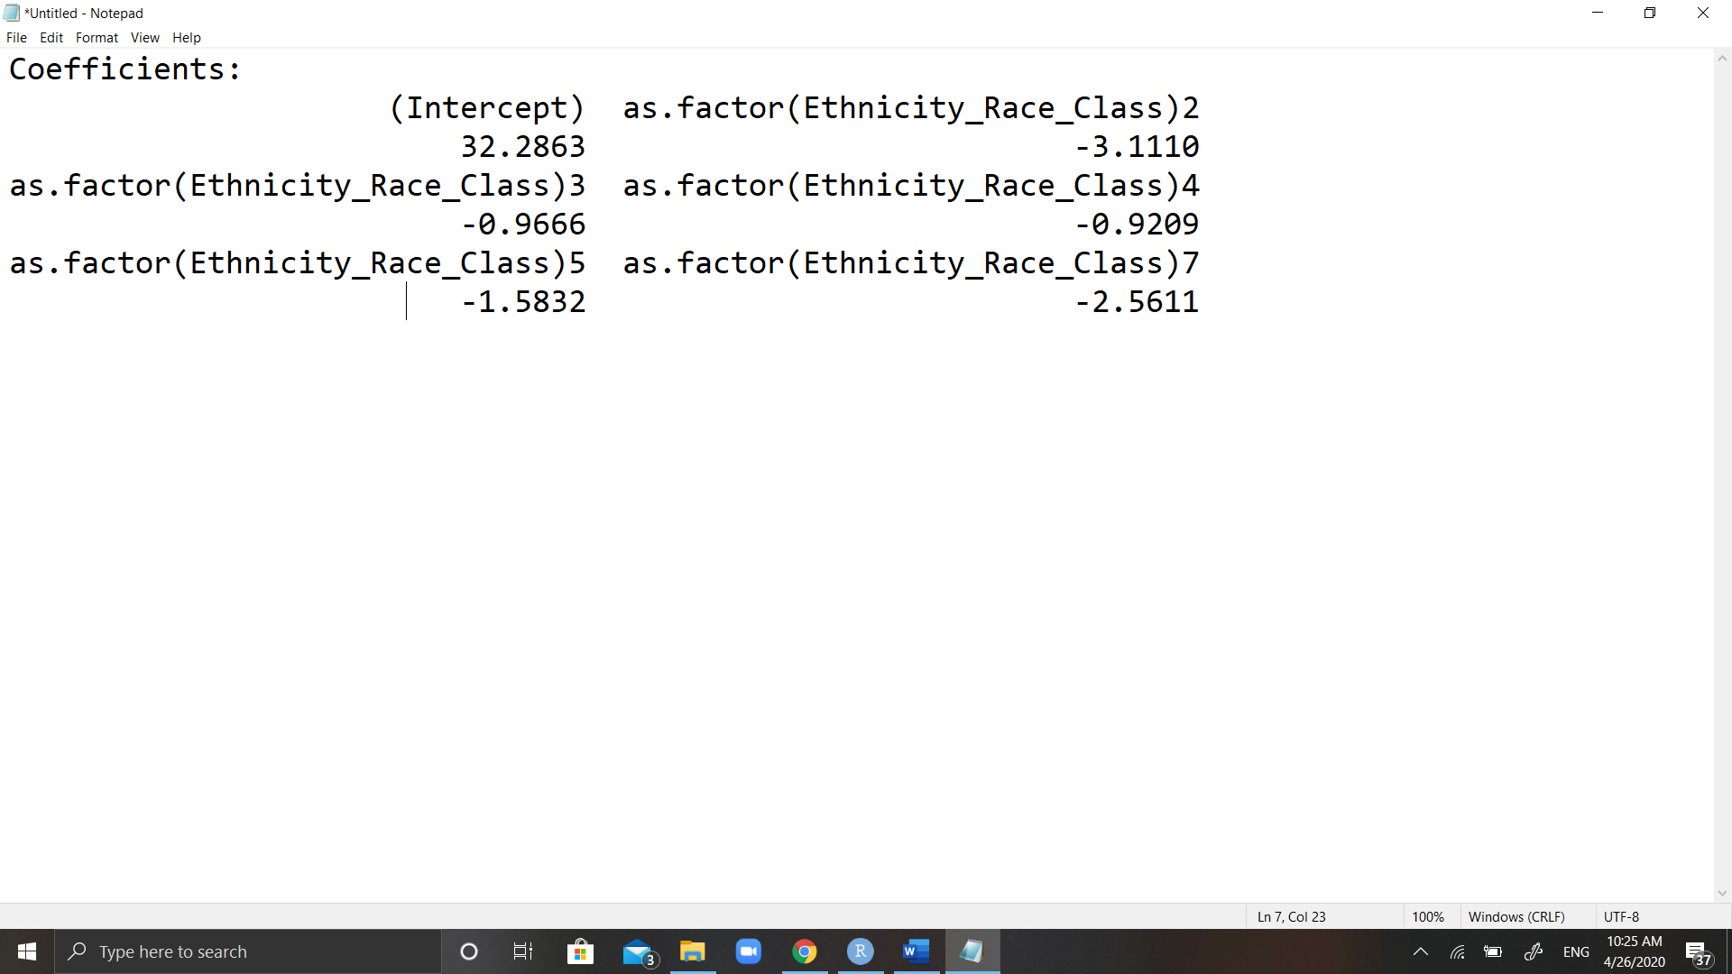
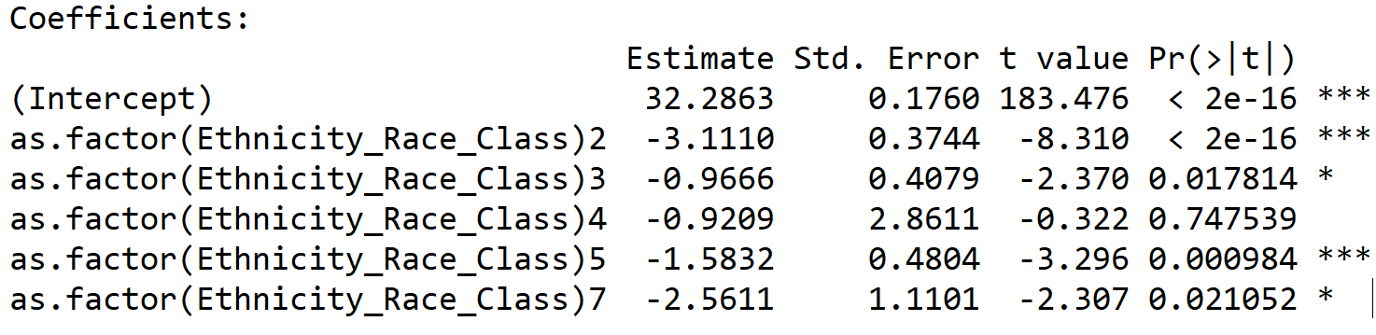
Other things that can be used
This shows us that certain race do have some factors and they do much better than other.
From these coefficients, we can say that Ethnicity 2 which is Black Non-Spanish-Hispanic-Latino survives less than other Ethnicity, while Ethnicity 3 and 4 which are White people and Black people from South or Central American excluding Brazil are doing much better and survives more than other ethnicities.

Slide 15
Potential Errors and future work
Since the data, I got is uses R and excel, it is bonded by it limits. R does not allow more than 1 million rows, so I was not able to utilize the whole data.
There might be some biased involve when calculation NPI score. Normalization needs to be done.
Finally , I only worked with TNB data(Triple negative Breast Cancer dataset) and there might be some more potential to analysis, data set as whole.

Slide 16
Any Questions? THANK YOU

